Slide 1
AI-Driven Archaeological Site Mapping
By
Alshifana.B

Slide 2
Introduction to AI-Driven Archaeological Site Mapping
This project presents an AI-powered system for archaeological site analysis using satellite and terrain data.
The platform integrates deep learning models to: Detect archaeological artifacts, Segment terrain features, Predict soil erosion risk
Designed to support archaeologists, researchers, and planners in early-stage site exploration.
Focuses on automation, accuracy, and visual decision support.

Slide 3
Technology Stack
Framework
Deep Learning
Computer Vision
Machine Learning
Data Processing
Visualization
PyTorch
Segmentation Models PyTorch (SMP)
OpenCV
YOLOv5
Streamlit
Scikit-Learn (Random Forest)
NumPy
Pandas
Matplotlib
PIL

Slide 4
Challenges
1. Manual archaeological surveys
Traditional surveys are time-consuming, costly, and difficult to scale across large or remote areas.
2. Terrain degradation and erosion
Erosion and landslides can damage or destroy
archaeological sites before they are discovered.
Existing satellite and geospatial data are underused due to limited AI-based analysis.
3. Limited use of AI

Slide 5
Core Features
Automated Artifact Detection
Terrain and Land-feature segmentation
AI models automatically identify archaeological artifacts from images.
Deep learning separates terrain features
from satellite imagery.
Unified visualization dashboard
Predictive erosion analysis
Machine learning predicts erosion risk using
environmental data.
A single dashboard displays all model outputs clearly.

Slide 6
Challenges
1. Manual archaeological surveys
Traditional surveys are time-consuming, costly, and difficult to scale across large or remote areas.
2. Terrain degradation and erosion
Erosion and landslides can damage or destroy archaeological sites before they are discovered.
3. Limited use of AI
Existing satellite and geospatial data are underused due to limited AI-based analysis.

Slide 7
Semantic Segmentation
Object Detection
YOLOv5 trained on annotated artifact images
Detects and classifies archaeological objects
U-Net trained on satellite and DEM data
Outputs pixel-level terrain classification
System Architecture
Erosion Prediction
Deployment
Regression-based ML model
Uses NDVI, slope, DEM, and climate features
Streamlit-based interactive dashboard

Slide 8
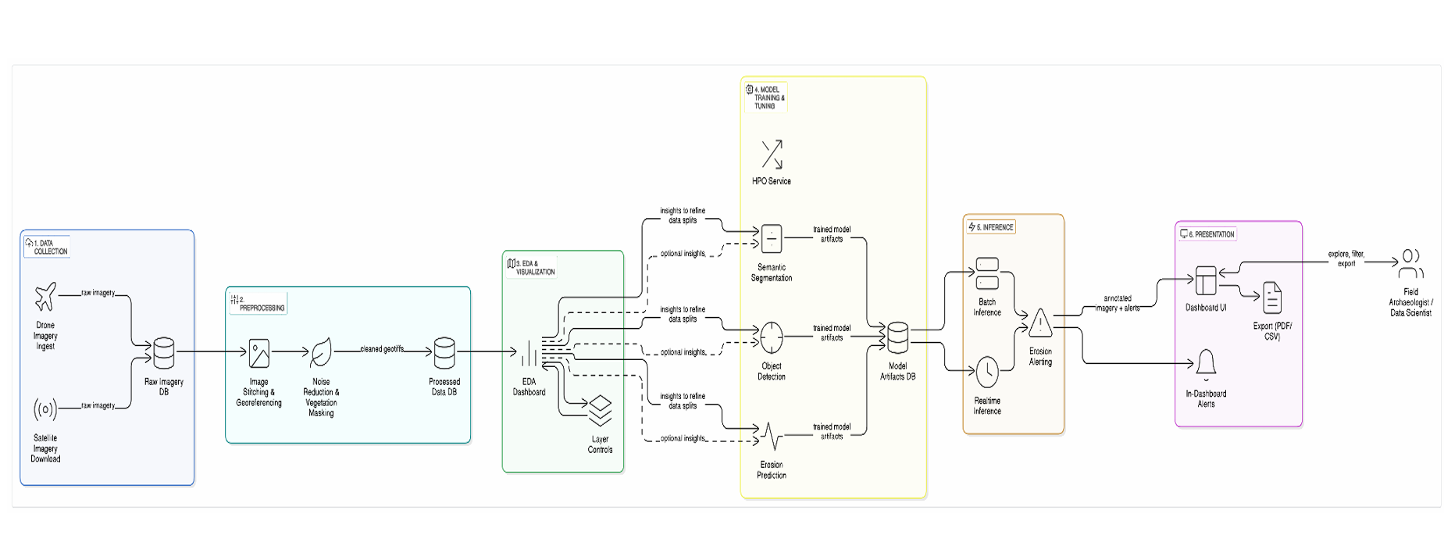
Architecture Diagram

Slide 9
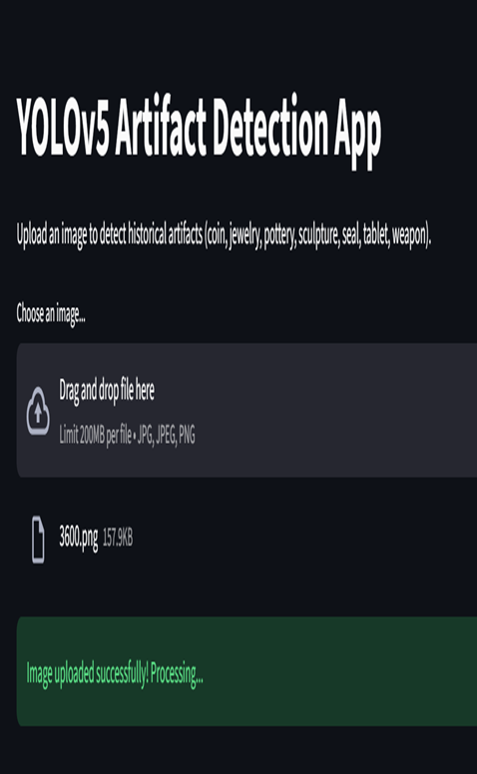
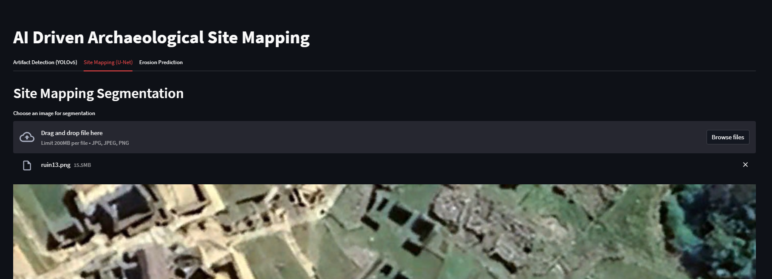
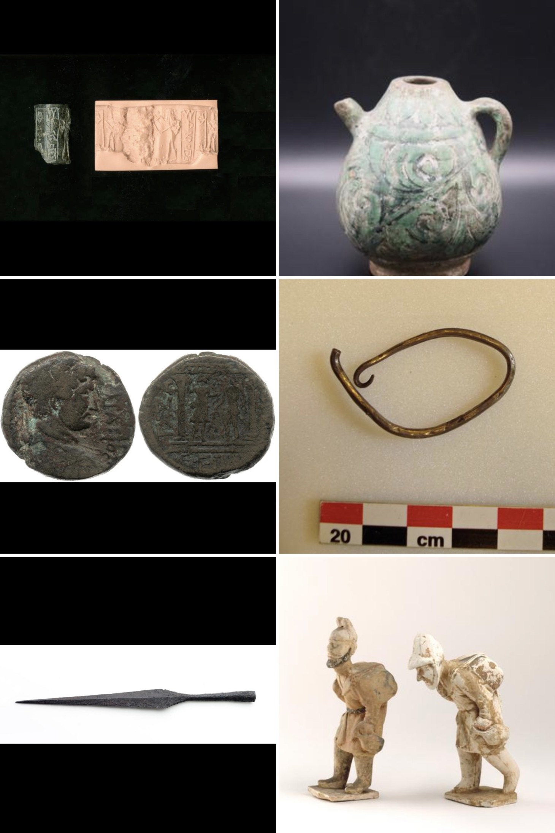
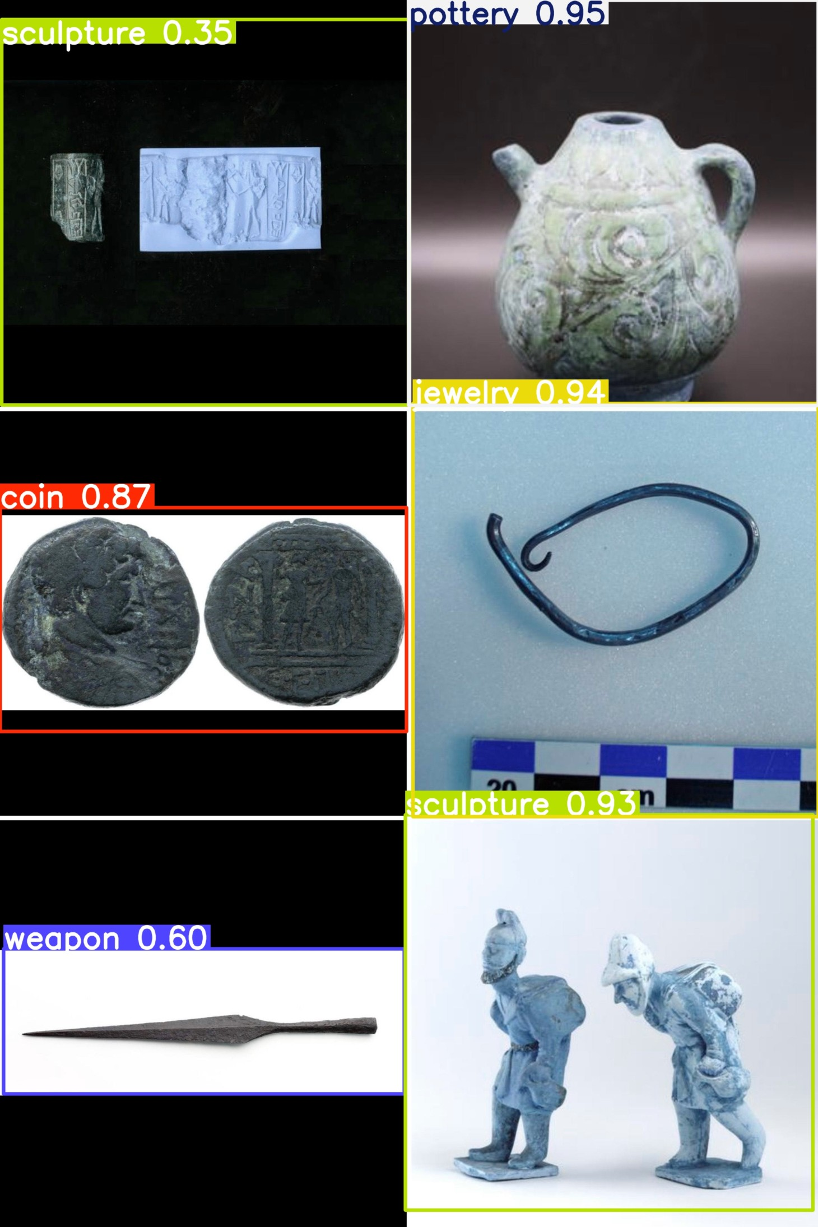
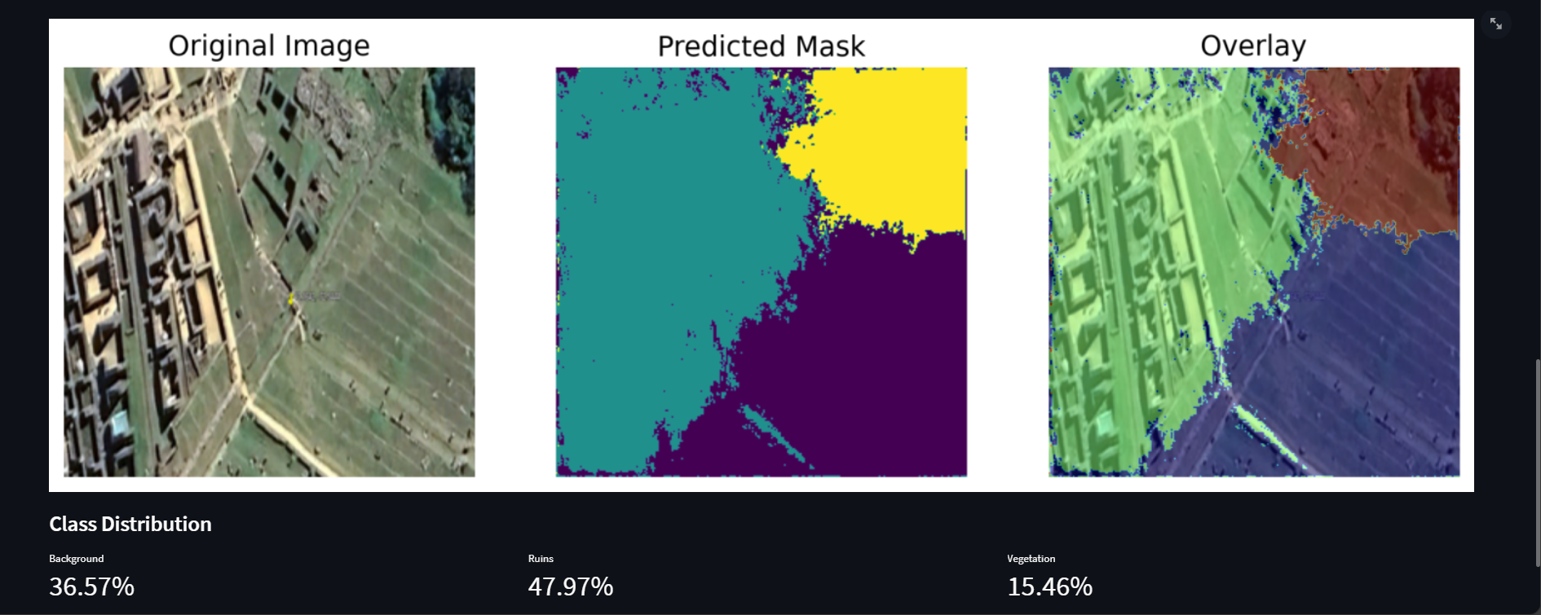

Slide 10
Presentation Video...
https://drive.google.com/file/d/1XII0v7jr2nGM-1PSZFaH-kwtJRLxhaWQ/view?usp=drive_link

Slide 11
Thank you
Q & A

